Slide 1


Major Project
Rush Hour
IMPROVED Traffic Control System (ITCS) to tackle heterogeneity of vehicles for green light timer computation using machine learning techniques.
Team Members :
Deepak Sharma | 19103003
Rahul Jindal | 19103033
Mayank | 19103042
Raman Ailawadhi | 19103061
Project Mentor: Dr. Sudesh Rani
Further Guidance received form:
Dr. Sanjay Kumar Batish Mr. Prabhsimran Singh Bindra
Mr. Sushil Kumar
Notes:
Work left → See fonts times new roman , heading 14 and bold and text 12 and citations
Workflow adjust , algorithm both left , conclusio

Slide 2
ABOUT THE TOPIC
Existing Traffic Detection System | Rush Hour
Inductive Loop oriented. | Camera Oriented.
Approximates the number of vehicles using the queue length formed by the vehicles. | Observes number as well as the types of vehicles for heterogeneous traffic management.
No information given to drivers on trustworthiness of different paths. | 0-1 TRUST SCORE value shown to drivers at all junctions to convey which path is trustworthy.
No system for prioritized green corridor. | Prioritized green corridor for emergency vehicles like ambulance and fire brigade.

Slide 3
OBJECTIVES AND PROBLEM STATEMENT
To study the existing traffic control systems and the techniques used to regulate traffic.
To design a system to provide green corridor to priority vehicles and an algorithm to provide trust score for each lane.
To implement the Improved Traffic Control System (ITCS) in PyGame and Raspberry Pi and a mobile app for priority vehicles.
To analyse the model in real time to improvise ITCS and trust score algorithms.
PROBLEM STATEMENT
“IMPROVED Traffic Control System (ITCS) to tackle heterogeneity of vehicles for green light timer computation, providing green corridor to priority vehicles and trust score for every lane.“

Slide 4
Literature Review
Sr. No. | Research Paper Title | Publication | Review
1 | De Oliveira, L. F. P., Manera, L. T., & da Luz, P. D. G, Development of a Smart Traffic Light Control System with Real-Time Monitoring [1] | IEEE Internet of Things Journal, Vol. 14, No. 8, 2020 | Development of wireless traffic light control system using XMesh network technology. Utilization of 2.4 GHz ISM non-licensed frequency band with transfer rate up to 2 Mbps. Implementation of redundant network technology for reliable communication. Features include a network coordinator device, initialization routine and synchronization of traffic lights.
2 | Kumar, N., Rahman, S. S., & Dhakad, Fuzzy Inference Enabled Deep Reinforcement Learning-Based Traffic Light Control for Intelligent Transportation System [2] | IEEE transactions on intelligent transportation systems, 2020, from IEEE Xplore | Adjusts the durations based on real-time traffic information. Combines deep reinforcement learning and fuzzy logic, optimal actions to reduce average waiting time using real-time data. Adapts to different traffic scenarios, prioritizes emergency vehicles, reduces waiting time, and improves overall traffic management.

Slide 5
Literature Review
Sr. No. | Research Paper Title | Publication | Review
3 | Karmakar, G., Chowdhury, A., Kamruzzaman, J., & Gondal, I. (2020). A Smart Priority Based Traffic Control System for Emergency Vehicles [3] | IEEE Sensors Journal, Volume: 21, Issue: 14, 15 July 2021 | The smart system assigns priority codes to emergency vehicles based on incident severity and estimates cell clearance time to reduce travel time. Traffic conditions and clearance times at signals used to optimize the route for emergency vehicles. Simulation results using SUMO demonstrate that increasing interventions can decrease travel time for emergency vehicles.
4 | Sundar, R., Hebbar, S., & Golla, V. (2015). Implementing Intelligent Traffic Control System for Congestion Control, Ambulance Clearance, and Stolen Vehicle Detection [4] | IEEE SENSORS JOURNAL, VOL. 15, NO. 2, FEBRUARY 2015 | The system uses RFID technology to track congestion volume and adjust signal timings accordingly to reduce congestion. The integration of ZigBee technology allows emergency vehicles to change traffic lights to green, enabling them to reach their destinations quickly and efficiently. By comparing RFID tags with a list of stolen vehicle RFIDs, the system can identify stolen vehicles and alert the authorities promptly.

Slide 6
Literature Review
Sr. No. | Research Paper Title | Publication | Review
5 | Qmulus – A Cloud Driven GPS Based Tracking System for Real-Time Traffic Routing [7] | IOSR Journal of Electronics and Communication Engineering (IOSR-JECE) ,Vol:7, No:1, 2013 | The cloud-based GPS system that provides possible path from source to destination with priority/score considering all the adversities like road blockage, weather etc. to driver through mobile app. Also used unsupervised learning to predict unforeseen accidents to update score of the path.
6 | Real Time Traffic Light Control Using Image Processing [8] | Indian Journal of Computer Science and Engineering (IJCSE), ISSN : 0976-5166, Vol:2, No:1, 2011 | Convert images into gray scale and compare it with empty road image and defined ranges of matching. If matching > 90% , gives red light for 60 sec 70-90%, gives green time for 20 sec 50-70%, gives green time for 30 sec <50%, gives green time for 60 sec

Slide 7
Literature Review
Sr. No. | Research Paper Title | Publication | Review
7 | IoT-based Traffic Signal Control for ambulance [9] | International Journal of Engineering and Advanced Technology (IJEAT) ISSN: 2249-8958 (Online), Volume-9 Issue-3, February 2020 | Used sound sensors to detect and control traffic lights for that lane. Used 2 sound sensors: one at traffic pole itself and another at 120m from traffic light pole. When sound detected at 120m, it will send turn the light green and when ambulance crosses traffic pole, sound sensor indicates to return back to normal.
8 | Smart Traffic Management System [10] | International Journal of Research Publication and Reviews Vol (2) Issue (2) (2021) Page 226-228 | If RFID reader at traffic pole detects ambulance, it will ask driver through mobile app for acknowledgement to turn the lights green or not. 2nd is driver itself is making API call through mobile app and request is passed on to respective traffic light arduino and lights are turned green.

Slide 8
Literature Review
Sr. No. | Research Paper Title | Publication | Review
9 | Study Of Automatic Traffic Signal System For Chandigarh [26] | International Journal Of Engineering Sciences & Research Technology, (I2or), Publication Impact Factor: 3.785, July, 2015 | Inductive loop used to detect presence and speed of vehicles Distance of inductive loop from junction and approach speed of vehicles used to then estimate the addition to green time until max green time is reached or no further vehicles are detected. Comparisons made with preset green signal times.
10 | Intelligent Traffic Management Systems: A Review [27] | International Journal For Innovative Research In Science & Technology, Volume 2, Issue 09, February 2016 | Different intelligent traffic management systems compared. VANET is efficient and can provide accident information, but GPS has to be installed on every device. RFID tags can be used for priority vehicles. Fuzzy logic takes number of vehicles and average speed of vehicles as input, can become very complex when more parameters involved. Infrared sensors and Video cameras are expensive.

Slide 9
Literature Review
Sr. No. | Research Paper Title | Publication | Review
11 | “Smart Traffic Light based on IoT and mBaaS using High Priority Vehicles Method” | 2018 5th International Conference on Electrical Engineering, Computer Science and Informatics (EECSI) | Mobile Application developed using Java and Android Studio NodeMCU used for communicating with backend using authentication key. Application finds the best route using Google Maps v2 and sends it along with the GPS data to backend, which is built using Firebase. Backend informs traffic light controllers to turn signal green whenever the ambulance is close to junction.
12 | “Ambulance Detection and Traffic Control System” | International Research Journal of Engineering and Technology (IRJET), Volume: 06 Issue: 04, Apr 2019 | SIM28 GPS Module, ESP8266 Node MCU Wi-Fi module and Raspberry pi 3B+ used to provide green corridor to ambulances. Whenever ambulance is 300m away from junction co-ordinates, signal sent to junction to provide green corridor. Green corridor stopped when ambulance 50m away from junction co-ordinates in the opposite direction.

Slide 10
Literature Review
Sr. No. | Research Paper Title | Publication | Review
13 | “Design of Intelligent Ambulance and Traffic Control” | International Journal of Innovative Technology and Exploring Engineering (IJITEE) ISSN: 2278-3075 (Online), Volume-2 Issue-5, April 2013 | Live heart rate and temperature of patient sent to doctors through SMS with GSM modem RFID used to identify ambulances to give green corridor
14 | “Smart Traffic Control System Using RFID” | International Research Journal of Engineering and Technology (IRJET), Volume: 07 Issue: 03, Mar 2020 | RFID sensor applied to all vehicles Vehicle type, priority of vehicle and time of the day used to provide green corridor and decide green signal time GSM used to send this data to server

Slide 11
Literature Review
Sr. No. | Research Paper Title | Publication | Review
15 | “Automatic Traffic Estimation Using Image Processing” | International Journal of Signal Processing, Image Processing and Pattern Recognition Vol. 5, No. 4, December, 2012 | Estimating the size of traffic in highways using image processing. The image of the highway is captured and used as a reference for image enhancement. Gamma correction and vehicle tracking (background elimination and lane masking) are applied to estimate the number of cars.
16 | “Image processing based Adaptive Traffic Control System” | IOSR Journal of Electronics and Communication Engineering (IOSR-JECE) ISSN: 2278-2834, ISBN: 2278-8735, PP: 33-37 | Uses cameras mounted on traffic signals to detect the number of vehicles. OpenCV and ML algorithms are used to classify the vehicles based on their size and shape. The system utilizes GSM technique to handle emergency vehicles and give them priority at the intersection.

Slide 12
Literature Review
Sr. No. | Research Paper Title | Publication | Review
17 | “Controlling Traffic Jam using Feature Detection and Object Detection Technique” | IOSR Journal of Mechanical and Civil Engineering (IOSR-JMCE) e-ISSN: 2278-1684, p-ISSN: 2320-334X PP 07-13 | The system utilizes cameras on traffic signals to detect traffic density and adjust signal timings accordingly. Feature detection and object detection techniques are used to process the captured images. The Canny edge detector algorithm is used to highlight regions with high spatial derivatives. Kadir and Brady's algorithm is used to identify traffic density at a particular position using entropy and scale.
18 | “Adaptive Traffic Management For Life Saving Services In Smart Cities” | International Journal of Creative Research Thoughts (IJCRT), Volume 10, Issue 11 November 2022 | Proposal to update Google Maps to alert drivers about the presence of an ambulance. GPS monitoring of ambulance movement to find the shortest route to the hospital. Drivers will receive an alert to move to the left side of the road to create a lane for the ambulance. System will notify traffic police to clear traffic jams and turn traffic lights green in advance.

Slide 13
Literature Review
Sr. No. | Research Paper Title | Publication | Review
19 | “Smart Ambulance with Traffic Control” | Journal of Emerging Technologies and Innovative Research (JETIR), June 2020, Volume 7, Issue 6 | Proposed an Android app to control traffic signals for ambulance movement. Three components: Android app for ambulance drivers and admins, RFID reader, and traffic signal with Arduino Nano board and RFID-RC522 Wi-Fi module. App allows ambulance drivers to log in, register patient info, and track location. Admin can view driver details and ambulance requests.
20 | “Advance Alert for Ambulance Pass by using IOT for Smart City” | International Journal of Engineering Science and Computing, June 2017 | Discusses using IoT technology to improve healthcare and transportation in India. Proposes a model to reduce deaths caused by traffic jams by notifying traffic signal systems or authorities in advance of the arrival of an ambulance. The model uses a client-server architecture and an Android/iOS application, with the server designed using PHP.

Slide 14



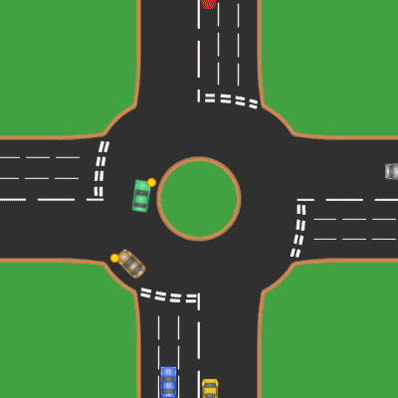
Work Done Till Last Semester
ITCS Algorithm Development
ML Model
Code written to analyze frames from a video and counting the no. of vehicles and of its type.
Idea Development
Created an algorithm to dynamically manage green signal timer.
Coded the algorithm.
Pygame Simulator Development
Reached out to Chandigarh SMART CITY Project Officials.
Discussed our idea and the problems they’re facing.
Built a simulator with Pygame library to visualize our dynamic traffic management on randomly generated data

Slide 15



Work Done This Sem Till Mid-Term
Hardware Implementation
Vehicle Prioritization system
Idea Development
Implemented the ITCS Algorithm and Pygame Simulator using Raspberry Pi, Camera and LED’s
Trust Score Feature
Algorithm developed to provide green corridor to priority vehicles.
Priority vehicles include ambulances, fire trucks.
Reached out to Ambulance Drivers outside Trauma Centre PGI.
Multiple brainstorming sessions with our mentors
Introduction of trust score parameter which ranges from 0-1.
Real time traffic and congestion data is fetched through Google and Open Weather APIs.

Slide 16



Work Done This Sem After Mid-Term
Mobile App Development
Data Collection with AWS
Implementation of Vehicle Prioritization system in Pygame
System Analysis
Developed mobile app using React Native for Priority Vehicles
Added Emergency response and Trust Score functionality to the App
Mapping of all junctions of Chandigarh done
Deployed AWS EC2 instance to collect congestion and weather data for all the junctions for 10 days
Pygame data analysis on ITCS algorithm and priority based algorithm
Generated tables and graphs for comparing both the algorithms on the waiting time of the priority vehicles
Code written to implement vehicle prioritization system in Pygame
4 separate cases for ambulance occurrence made to maximize efficiency

Slide 17
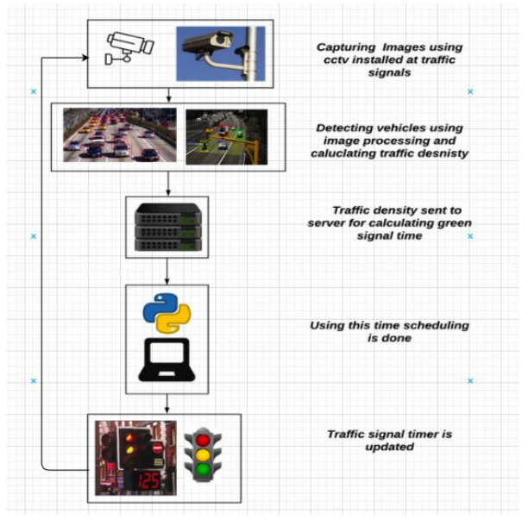
WORKFLOW

Slide 18
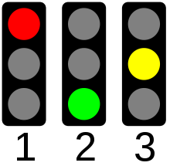
Priority Vehicle Algorithm
Case 1: PV at current green
signal
Case 3: PV at current red
signal
Case 2: PV at current yellow signal
Case 4: PV at next green signal
Notes:
Case 3 and case 4 → Mayank

Slide 19
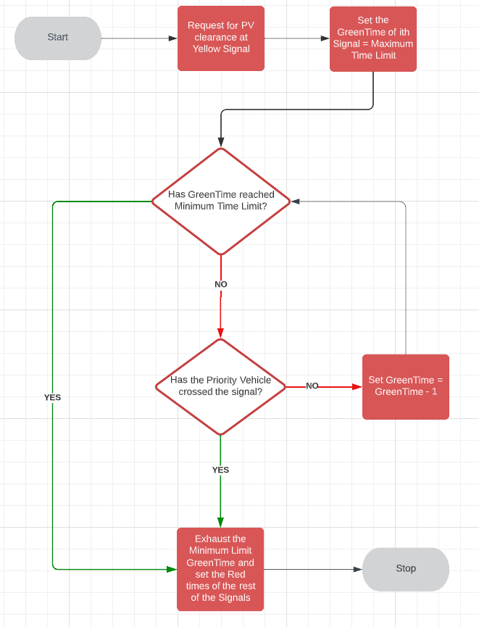
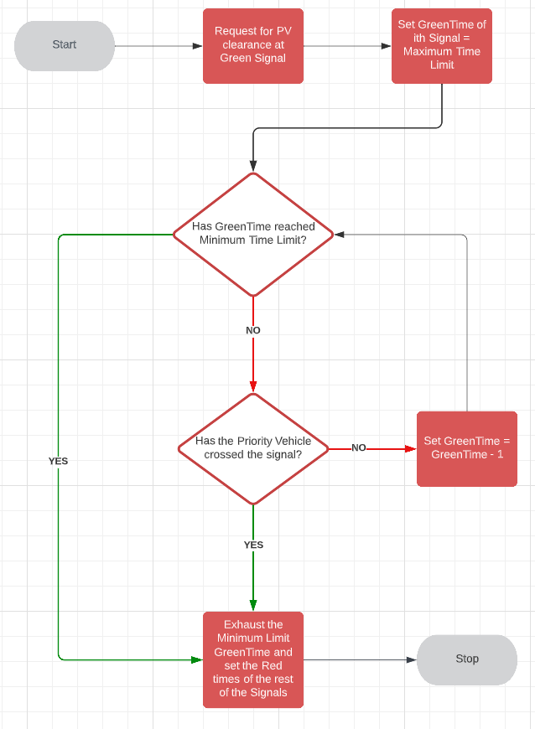
https://lucid.app/lucidchart/da481439-add8-427c-961d-a613d765b8a9/edit?viewport_loc=-1003%2C-1560%2C7354%2C3637%2C0_0&invitationId=inv_39c161de-745c-4dcd-b620-c50816653b4e

Slide 20
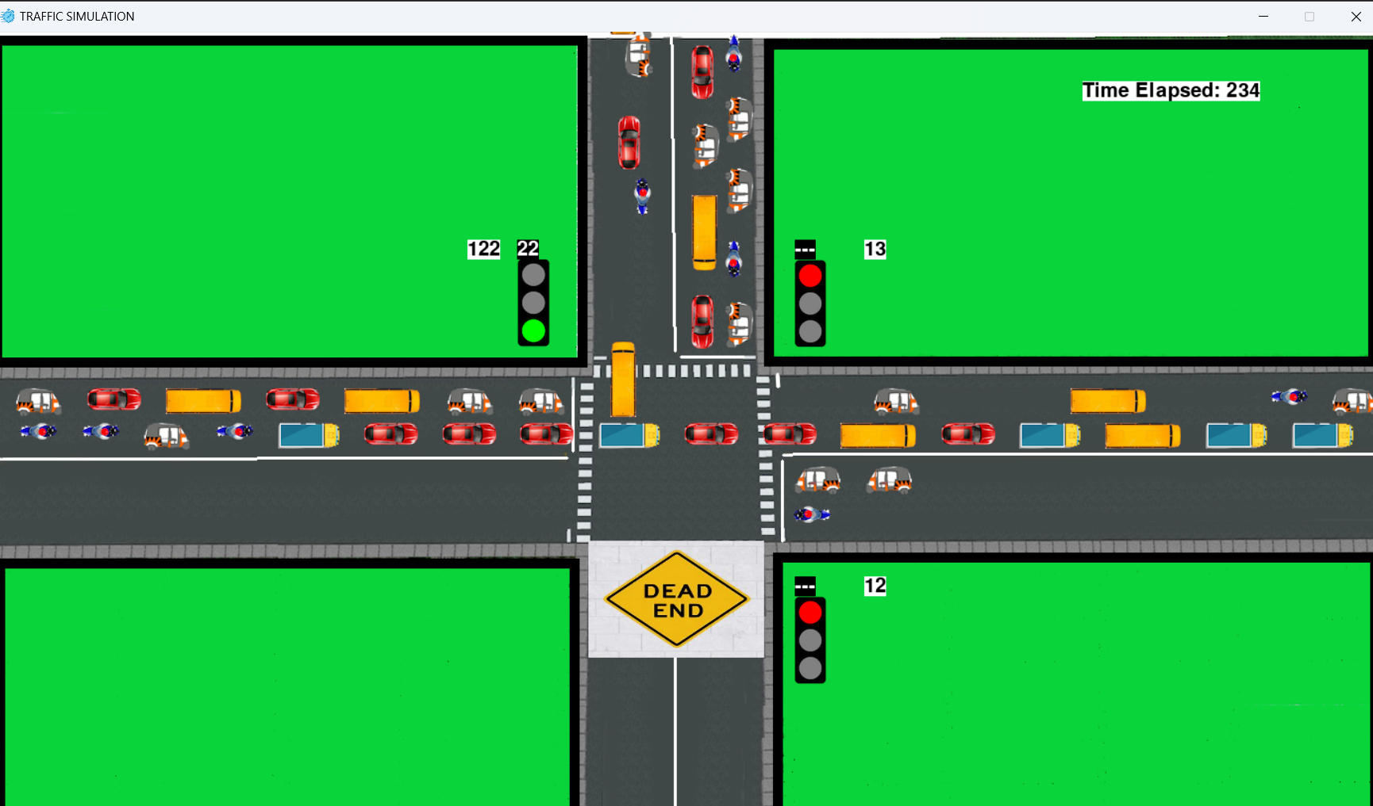
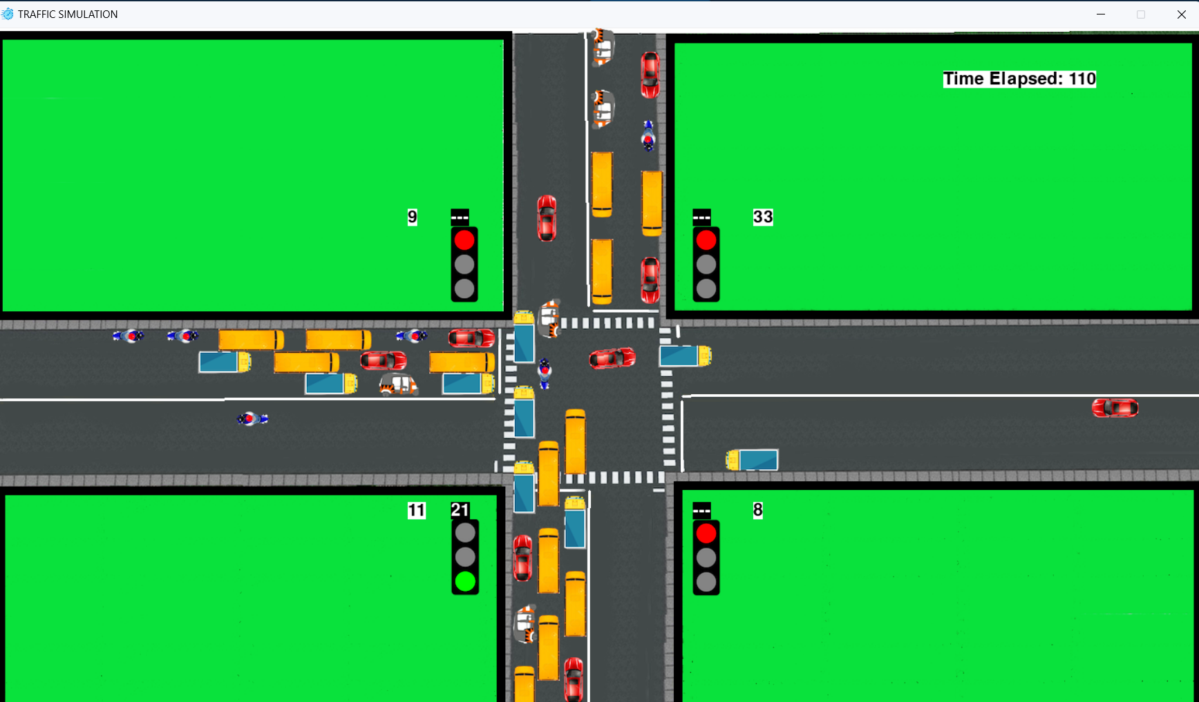
Results And Inferences
3 way
4 way
Pygame Simulator

Slide 21
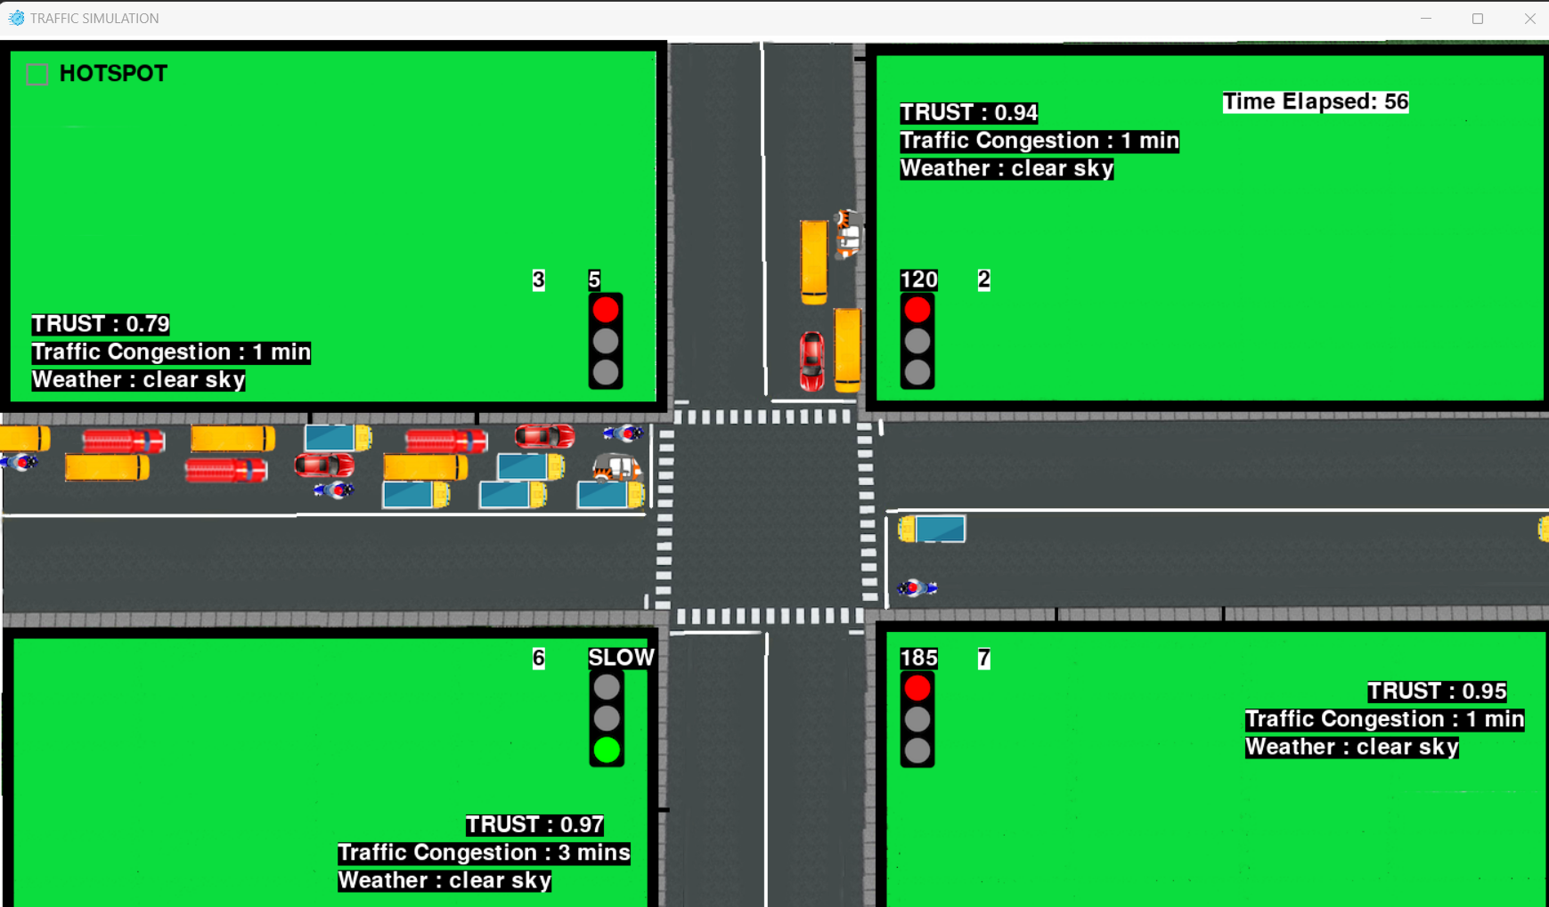
Results And Inferences
Pygame Simulator

Slide 22

Results And Inferences

Slide 23
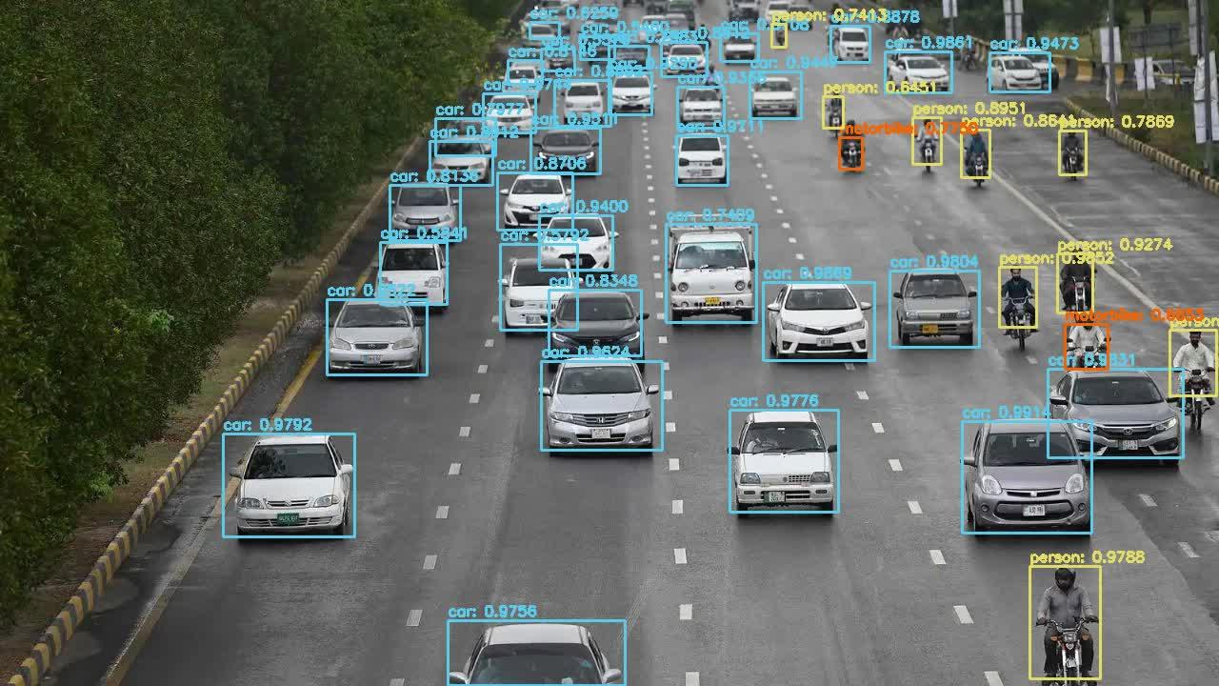
Results And Inferences
YOLO Model Output

Slide 24
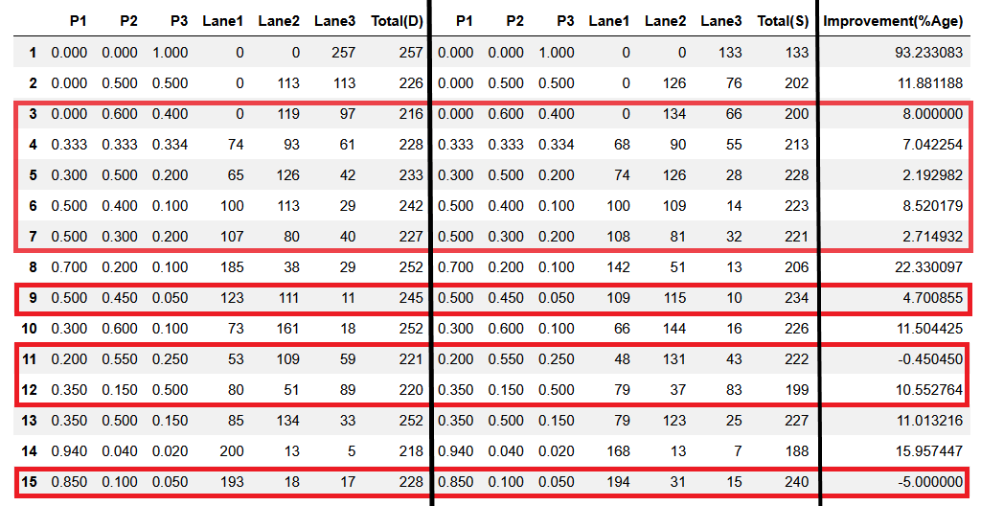
Results And Inferences
Dynamic System
Static System
3 - WAY SYSTEM
Notes:
Improvement = (No. of vehicles crossed in dynamic - no. of vehicles crossed in static) / no. of vehicles crossed in static [considering same simulation time]
Total(D) - tells the number of vehicles passed using Dynamic Timer
Total(S) - Tells the number of vehicles passed using Static Timer

Slide 25
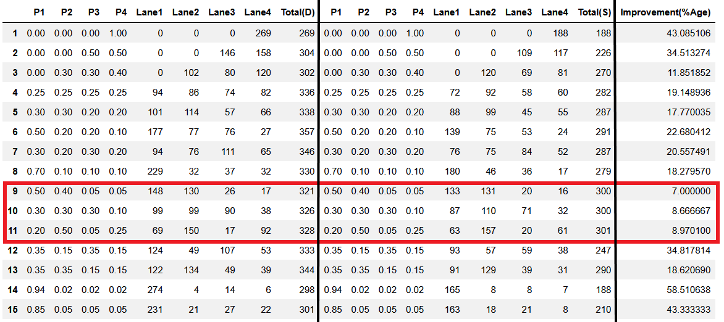
Results And Inferences
Dynamic System
Static System
4 - WAY SYSTEM

Slide 26
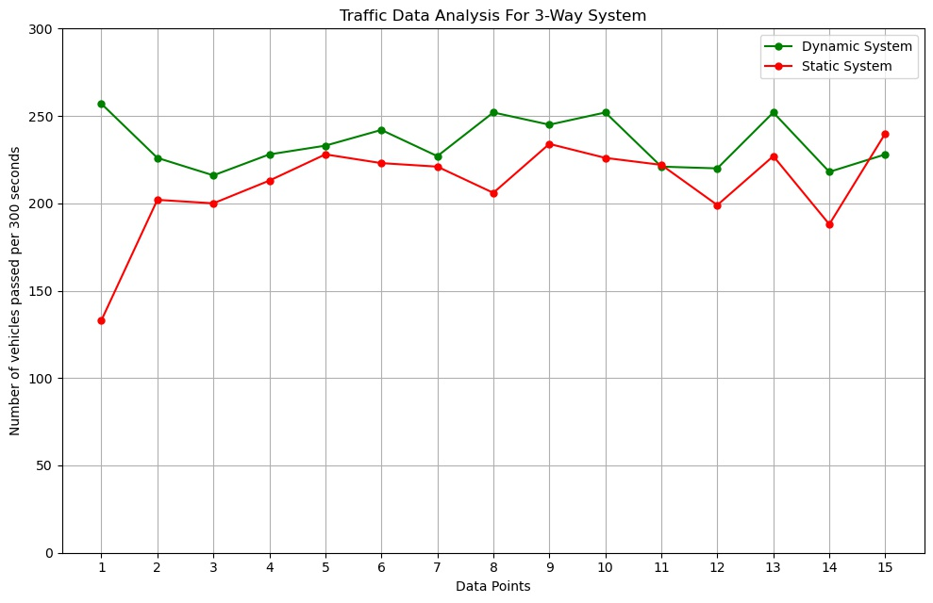
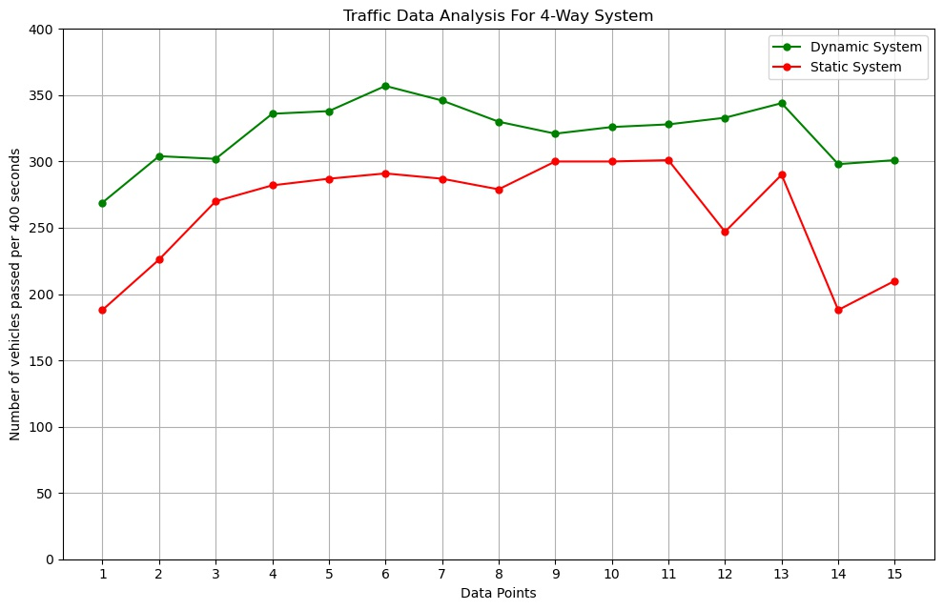
Results And Inferences
3 - Way System
4 - Way System
Notes:
Simulation time for 3-way - 300 sec
Simulation time for 4-way - 400 sec
X-axis - Data points - Number of vehicles distributed on the lanes
Y- axis - Number of vehicles passed in specified simulation time

Slide 27
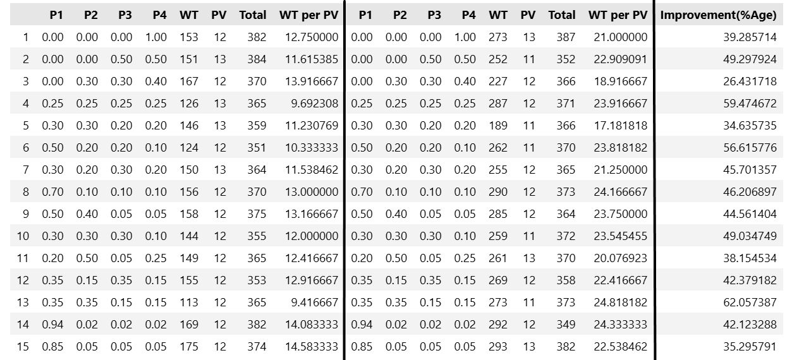
Results And Inferences
ITCS + Priority System
ITCS System
Priority Vehicle Delay T = 30 sec

Slide 28
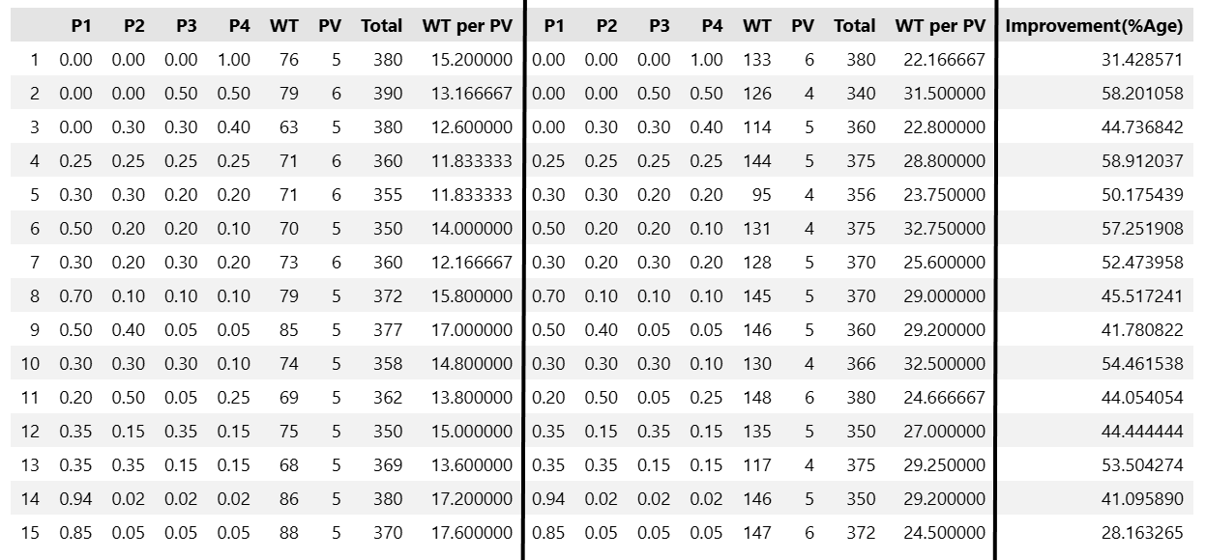
Results And Inferences
ITCS + Priority System
ITCS System
Priority Vehicle Delay T = 60 sec

Slide 29
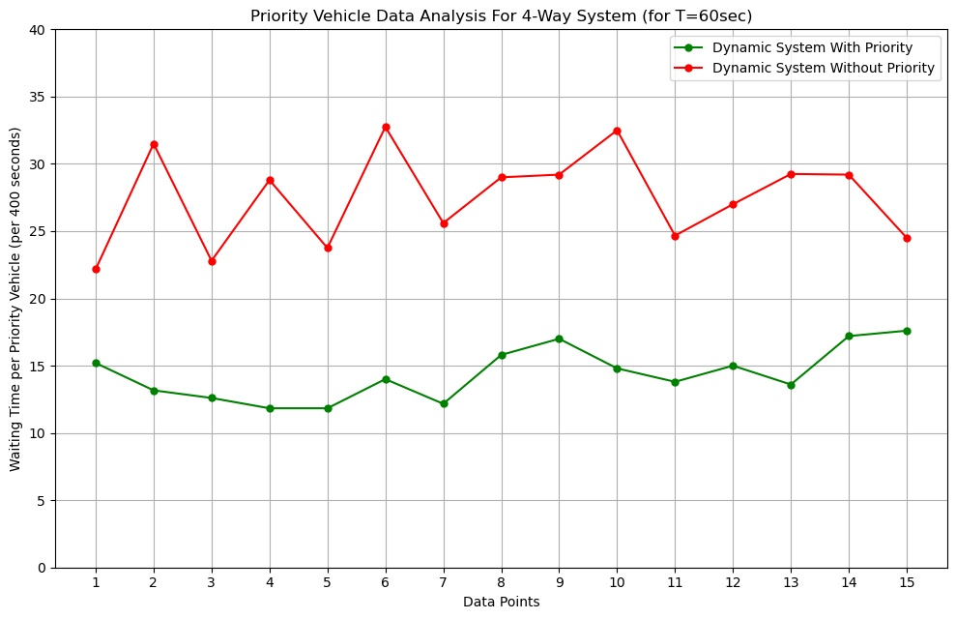
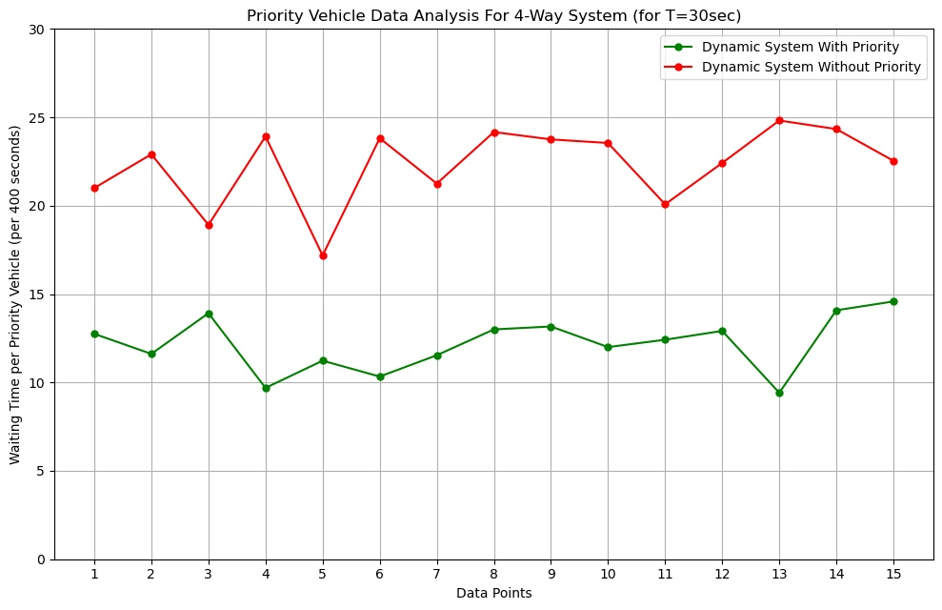
Results And Inferences
Priority Vehicle Time Saved for 4-Way System

Slide 30
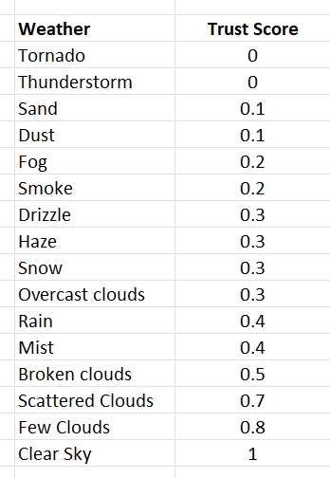
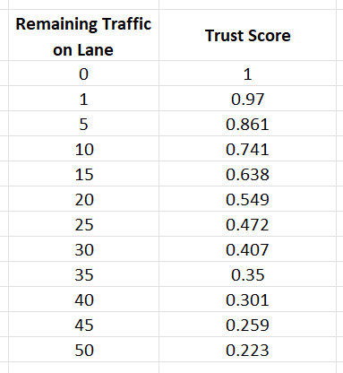
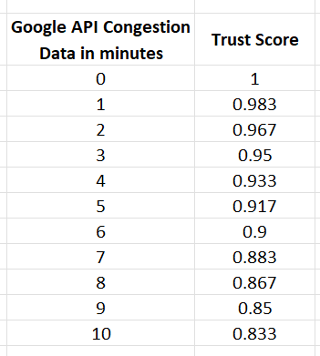
Trust Score Parameters

Slide 31
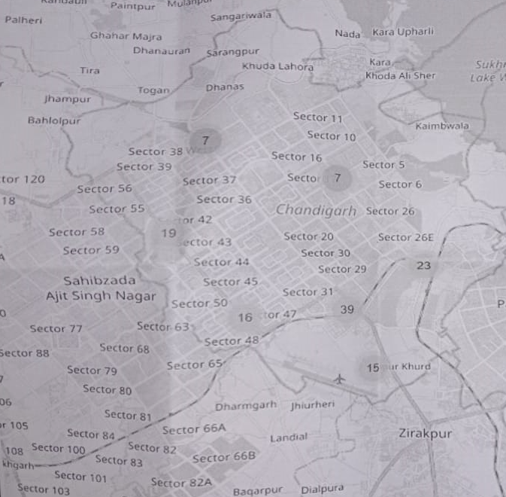
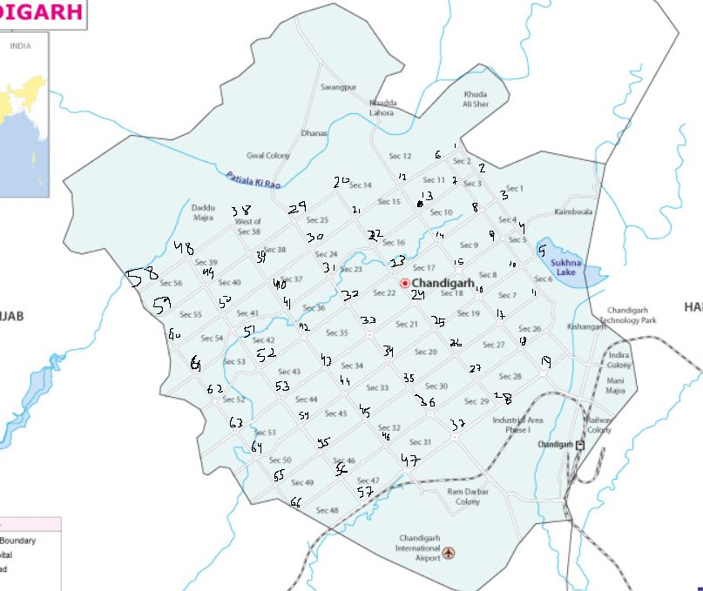

Slide 32
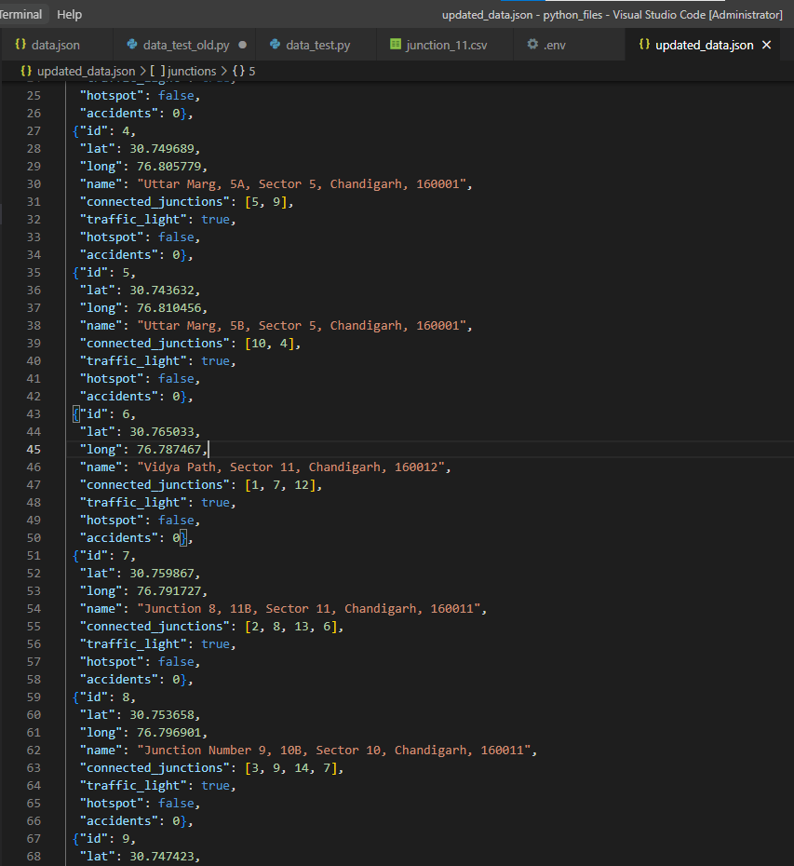
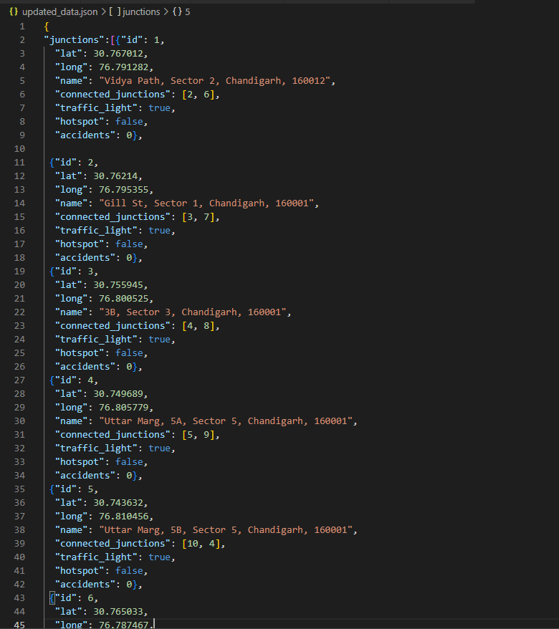

Slide 33
Results And Inferences

Slide 34
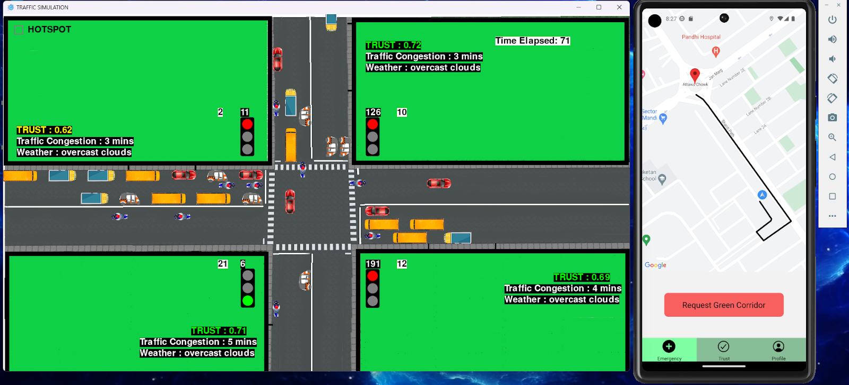
Results And Inferences

Slide 35
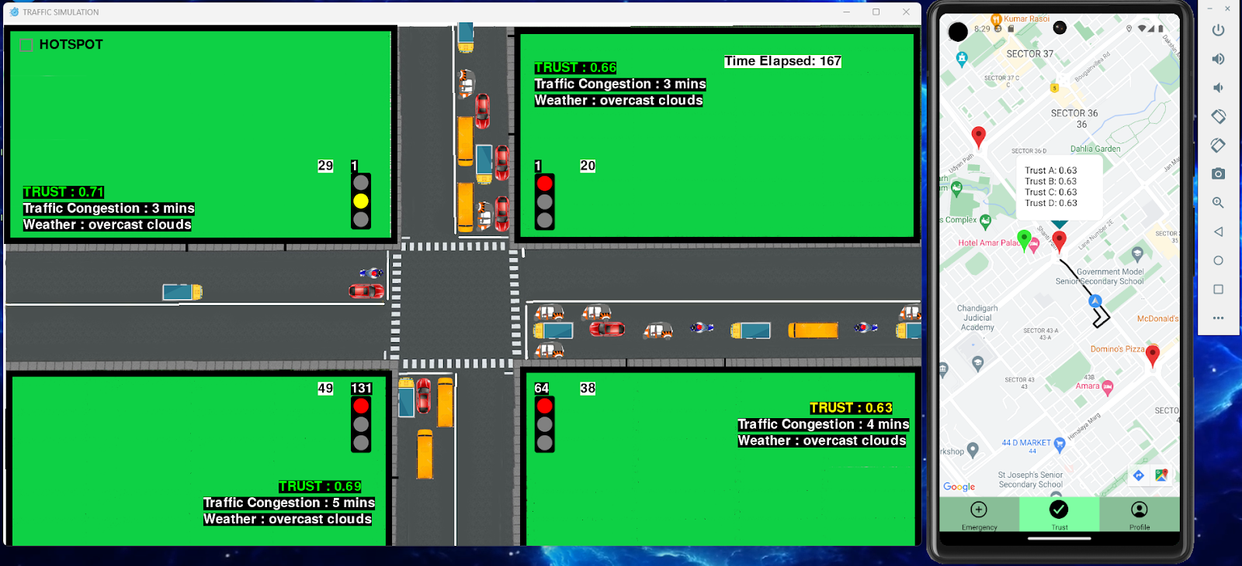
Results And Inferences

Slide 36
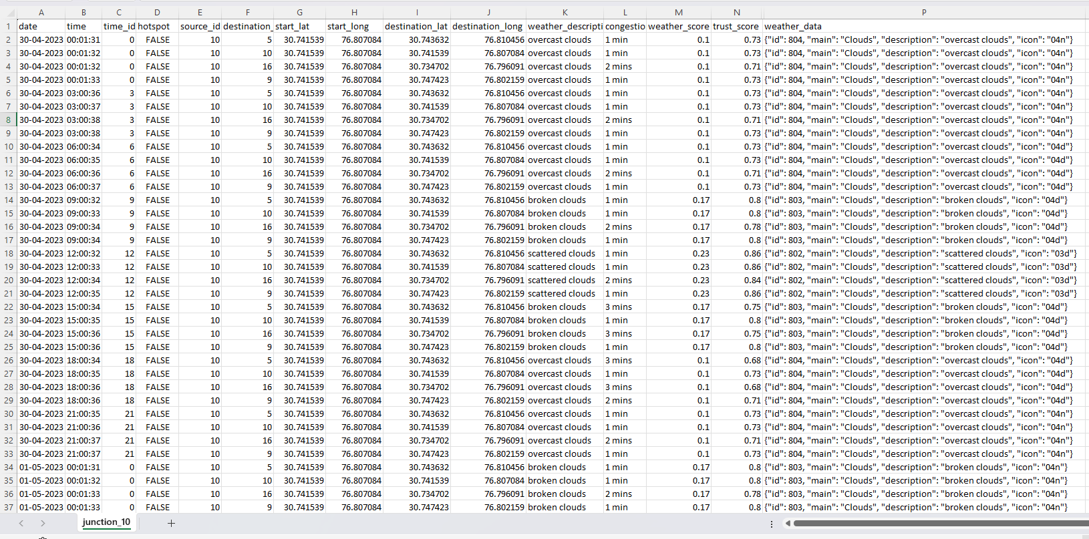

Slide 37
Results And Inferences

Slide 38
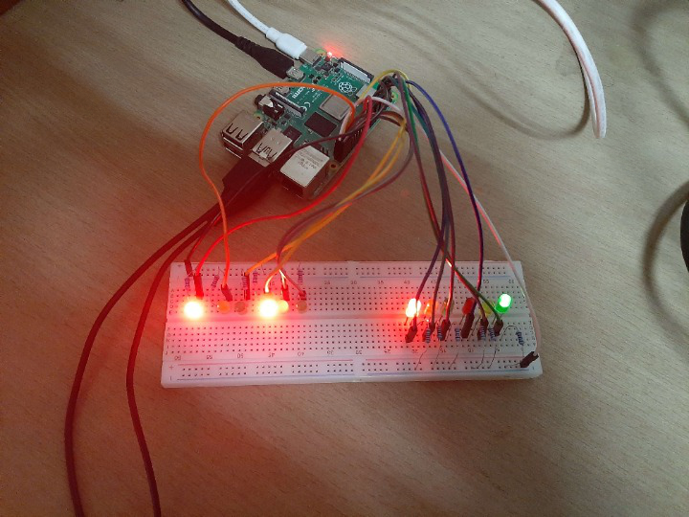
Results And Inferences
Hardware Demo

Slide 39







Hardware and Technologies Used
ML Model
Data Collection
Firebase
Simulation
Mobile App
ITCS Algorithm
Raspberry Pi 4

Slide 40
TOTAL TIMELINE
Work Done This Sem before Mid Term
Work Done This Sem After Mid Term
Work Done Last Sem
Vehicle Detection Module
Signal Switching Module
Simulation Module for ITCS Algorithm in Pygame
System Analysis for 4-way and 3-way junction systems
Hardware Implementation with Raspberry Pi 4
Trust Score Algorithm Development and Implementation
Priority Vehicles Algorithm Development
Priority Vehicle Algorithm Implementation
Mobile Application Module Development
System Analysis on Waiting times of Priority Vehicles
Data Collection with AWS

Slide 41
Future Work
Using the congestion and weather data of Chandigarh collected from AWS to predict trust scores with machine learning.
Mapping junctions and collecting weather and congestion data for adjoining cities of Chandigarh.
Adding more variables to trust score algorithm such as pollution levels.
Publishing the app on the App Store and Google Play Store.
Drafting and publishing a research paper.

Slide 42
Conclusion
The proposed system sets the green signal time adaptively according to the traffic density at the signal and ensures that the direction with more traffic is allotted a green signal for a longer duration of time as compared to the direction with lesser traffic which also took heterogeneity of vehicles into consideration.
The system shows about 24.52% improvement for 4 lane roads and 13.61% for 3 lane roads over the current static system in terms of the number of vehicles crossing the intersection in a given time frame, which is a significant improvement.
The system shows about 44.75% improvement when the priority vehicle arrives every 30 seconds and about 47.08% improvement for 60 seconds over the current ITCS system, so it can significantly reduce the time taken for emergency vehicles to reach their destination, potentially saving many lives.
We have successfully implemented a hardware system using Raspberry Pi 4 and LEDs. We have also introduced a new feature, the Trust Score, which ranges from 0 to 1 and is evaluated using real-time information on traffic and weather obtained through Google and Open Weather APIs.

Slide 43
References
[1] De Oliveira, L. F. P., Manera, L. T., & da Luz, P. D. G. (2020). Development of a Smart Traffic Light Control System with Real-Time Monitoring. IEEE Internet of Things Journal, 1–1. doi:10.1109/jiot.2020.3022392
[2] Kumar, N., Rahman, S. S., & Dhakad, N. (2020). Fuzzy Inference Enabled Deep Reinforcement Learning-Based Traffic Light Control for Intelligent Transportation System. IEEE Transactions on Intelligent Transportation Systems, 1–10. doi:10.1109/tits.2020.2984033
[3] Karmakar, G., Chowdhury, A., Kamruzzaman, J., & Gondal, I. (2020). A Smart Priority Based Traffic Control System for Emergency Vehicles. IEEE Sensors Journal, 1–1. doi:10.1109/jsen.2020.3023149
[4] Sundar, R., Hebbar, S., & Golla, V. (2015). Implementing Intelligent Traffic Control System for Congestion Control, Ambulance Clearance, and Stolen Vehicle Detection. IEEE Sensors Journal, 15(2), 1109–1113. doi:10.1109/jsen.2014.2360288
[5] Application of Image Processing In Road Traffic Control, International Journal of Advanced Research Trends in Engineering and Technology (IJARTET), Vol. 2, Issue 4, April 2015
[6] Traffic Light Control and Violation Detection Using Image Processing, IOSR Journal of Engineering (IOSRJEN), vol. 08, no. 4, 2018, pp. 23-27
[7] Qmulus – A Cloud Driven GPS Based Tracking System for Real-Time Traffic Routing, IOSR Journal of Electronics and Communication Engineering (IOSR-JECE), Vol:1, No:1, 2013
[8] Real Time Traffic Light Control Using Image Processing, Indian Journal of Computer Science and Engineering (IJCSE), Vol:2, No:1, 2011
[9] IoT-based Traffic Signal Control for ambulance, International Journal of Engineering and Advanced Technology (IJEAT) ISSN: 2249-8958 (Online), Volume-9 Issue-3, February 2020
[10] Smart Traffic Management System, International Journal of Research Publication and Reviews Vol (2) Issue (2) (2021) Page 226-228

Slide 44
References
[11] Design of Intelligent Ambulance and Traffic Control, International Journal of Innovative Technology and Exploring Engineering (IJITEE) ISSN: 2278-3075 (Online), Volume-2 Issue-5, April 2013
[12] Smart Traffic Control System Using RFID, International Research Journal of Engineering and Technology (IRJET), Volume: 07 Issue: 03, Mar 2020
[13] Automatic Traffic Estimation Using Image Processing, International Journal of Signal Processing, Image Processing and Pattern Recognition Vol. 5, No. 4, December, 2012
[14] Image processing based Adaptive Traffic Control System, IOSR Journal of Electronics and Communication Engineering (IOSR-JECE) ISSN: 2278-2834, ISBN: 2278-8735, PP: 33-37
[15] Controlling Traffic Jam using Feature Detection and Object Detection Technique, IOSR Journal of Mechanical and Civil Engineering (IOSR-JMCE)e-ISSN: 2278-1684, p-ISSN: 2320-334XPP 07-13
[16] Adaptive Traffic Management For Life Saving Services In Smart Cities, International Journal of Creative Research Thoughts (IJCRT), Volume 10, Issue 11 November 2022
[17] Smart Ambulance with Traffic Control, Journal of Emerging Technologies and Innovative Research (JETIR), June 2020, Volume 7, Issue 6
[18] Advance Alert for Ambulance Pass by using IOT for Smart City, International Journal of Engineering Science and Computing, June 2017
[19] A. Vogel, I. Oremović, R. Šimić and E. Ivanjko, "Improving Traffic Light Control by Means of Fuzzy Logic," 2018 International Symposium ELMAR, Zadar, 2018, pp. 51-56, doi: 10.23919/ELMAR.2018.8534692.

Slide 45
References
[20] A. A. Zaid, Y. Suhweil and M. A. Yaman, "Smart controlling for traffic light time," 2017 IEEE Jordan Conference on Applied Electrical Engineering and Computing Technologies (AEECT), Aqaba, 2017, pp. 1-5, doi: 10.1109/AEECT.2017.8257768.
[21] A. Kanungo, A. Sharma and C. Singla, "Smart traffic lights switching and traffic density calculation using video processing," 2014 Recent Advances in Engineering and Computational Sciences (RAECS), Chandigarh, 2014, pp. 1-6, doi: 10.1109/RAECS.2014.6799542.
[22] Siddharth Srivastava, Subhadeep Chakraborty, Raj Kamal, Rahil, Minocha, “Adaptive traffic light timer controller” , IIT KANPUR, NERD MAGAZINE.
[23] TomTom.com, 'Tomtom World Traffic Index', 2019. [Online]. Available: https://www.tomtom.com/en_gb/traffic-index/ranking/
[24] Pygame Library, 2019. [Online]. Available: https://www.pygame.org/wiki/about
[25] Open Data Science, ‘Overview of the YOLO Object Detection Algorithm’, 2018. [Online]. Available: https://medium.com/@ODSC/ overview-of-the-yolo-object-detection-algorithm-7b52a745d3e0
[26] Study Of Automatic Traffic Signal System For Chandigarh, International Journal Of Engineering Sciences & Research Technology, (I2or), Publication Impact Factor: 3.785, July, 2015
[27] Intelligent Traffic Management Systems: A Review, International Journal For Innovative Research In Science & Technology, Volume 2, Issue 09, February 2016

Slide 46
Thank You!

